Slide 1

A Brief Walkthrough…

Slide 2
Our agenda of the meeting today?

Slide 3
To understand the possibilities in the Residential Realty of Gurgaon.

Slide 4


Buyer’s/ Investor’s Apprehensions!
LOCATION?

Slide 5



Greenery?
Luxury ?
Security ?
Location ?
Amenities ?
Infrastructure ?
Connectivity ?

Slide 6
BUT,
Studies & Surveys show that market is quite conducive. Even today!
Let us answer how…

Slide 7
What do we need to understand?
WHAT is/are the available option/s?
WHERE to invest?
WHAT to pick?
WHEN is the right time?
HOW to go about it?

Slide 8
Investment Options available…

Slide 9
Latest Investment Portfolio
Investment Option | % ROI | % Capital Appreciation | Facts and Features
Residential | 1 – 2% | 10 – 15% | Good Capital appreciation achieved through flipping the property frequently & Higher capital appreciation when held for a longer period. Rental Returns
Gold | Nil | 6 – 7% | Average Capital Appreciation with no returns High volatility
Stock | 1% | 8 – 9% | High risk exposure due to unstable market conditions.
Fixed Deposit | 9% | Nil | Fixed stable return with no capital appreciation

Slide 10
Latest Investment Portfolio
Investment Option | % ROI | % Capital Appreciation | Facts and Features
Residential | 1 – 2% | 10 – 15% | Good Capital appreciation achieved through flipping the property frequently & Higher capital appreciation when held for a longer period. Rental Returns
Gold | Nil | 6 – 7% | Average Capital Appreciation with no returns High volatility
Stock | 1% | 8 – 9% | High risk exposure due to unstable market conditions.
Fixed Deposit | 9% | Nil | Fixed stable return with no capital appreciation
The undisputed leader, indeed!

Slide 11
Having seen that ROI in Residential Projects is remarkable, it’d be wise to now figure out WHERE lies the maximum potential now.

Slide 12
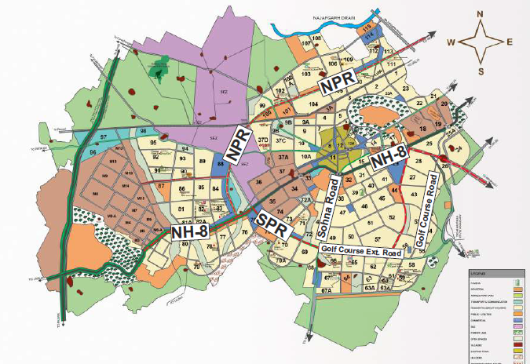
Zonal distribution of the entire City:
SPR- Southern Periphery Road; NPR- Northern Periphery Road; NH8- National Highway 8

Slide 13
Major Residential Zones
Golf Course Road
Golf Course Extension Road
Sohna Road

Slide 14
GURGAON
Golf Course Road
Golf Course Extension Road
Sohna Road
Delivered Projects
Delivered Projects
Delivered Projects
Ongoing Projects
Ongoing Projects
Ongoing Projects
Current SCOPE
Current SCOPE
Current SCOPE

Slide 15
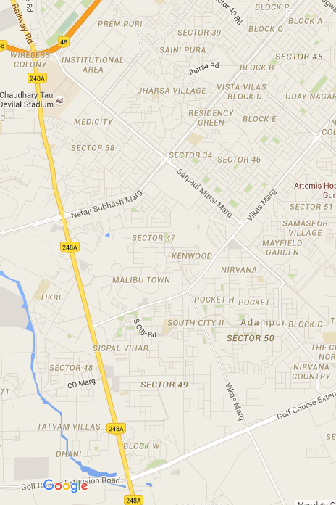
Sohna Road
120 mtr. Wide road with Rapid Metro
Excellent connectivity from NH8, Manesar, Golf Course Extn Road, South Delhi, Airport
Mix of Grade A, B, C – Commercial supply
Approx. 20 minutes from International airport
Commercial & Retail hub surrounded by upscale residential areas
Highest Commercial space in Gurgaon

Slide 16
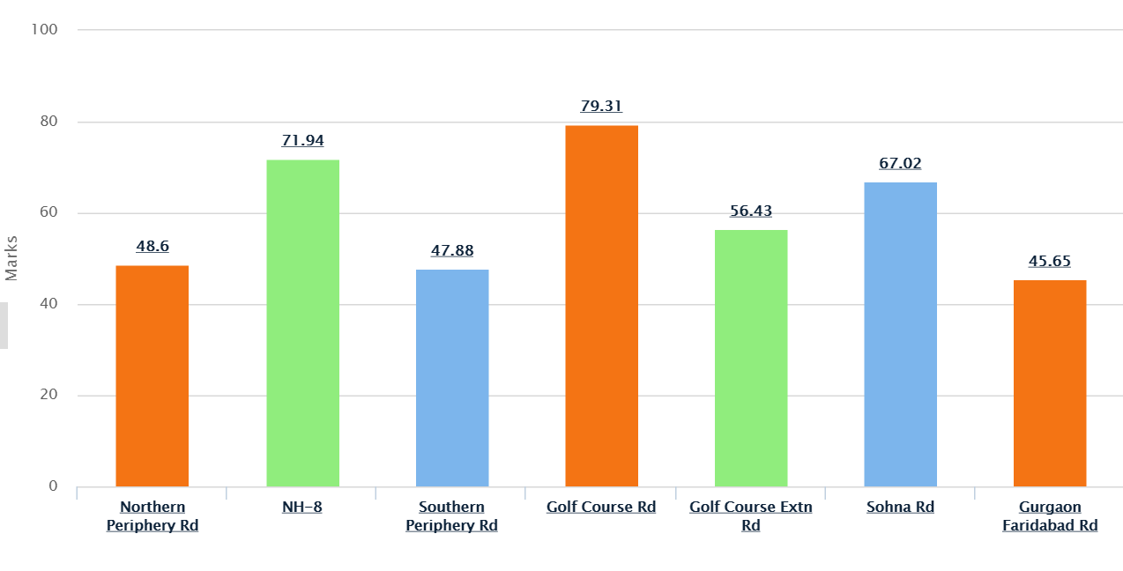
Locality Livability - Investment Index
Locality ratings based on their livability and real estate perspective.

Slide 17
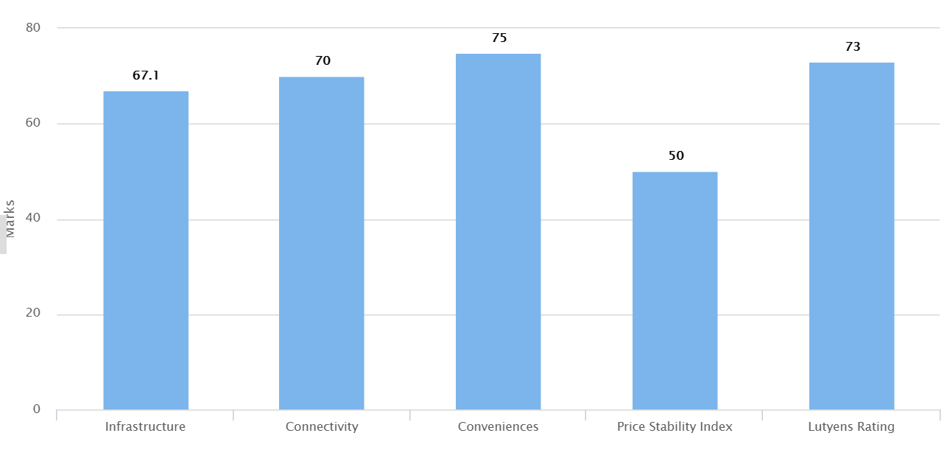
Sohna Road Locality Index

Slide 18
Why Sohna Road?
Excellent connectivity with the emerging commercial hub, Golf Course Extension Road and National Highway 8.
It will be further connected to the Southern and Northern Periphery Roads.
An excellent mix of retail, commercial and residential properties. Developers like Raheja, Unitech, Omaxe, CHD, Ansal, Parsvnath, Eldeco, Vipul, Gold Souk etc., have developed a number of residential, commercial and retail properties in this region.
Good ready-to-move-in options are available on this road in the price range of Rs 8,000-11,000 per sq ft.
The area is still affordable compared to other locations like MG Road and Golf Course Road, etc.

Slide 19
Why Sohna Road?
The under-construction projects are located in sectors along the Southern Peripheral Road, which is a 150-metre wide road connecting Golf Course Extension to NH-8 intersecting Sohna Road at Badshahpur.
A number of companies like Cognizant, TNS Global, Software One, Huawei, Pfizer, Atos and Rockwell Automation, have leased large offices in this area, which will further boost the residential demand in this locality.
The Haryana government has envisaged development of theme hubs, namely Leisure Hub, Sports Hub and Leather Hub along the KMP Expressway in the vicinity of Sohna.
Investors looking for affordable options and long-term investment horizons may go for investment in this area. The value of the investments is likely to appreciate once various infrastructure projects and industrial estates are up and running.

Slide 20
What HNIs Look For In A Luxurious Property?
Few parameters when it comes to buying a luxury residence:
The profile of the residents
Low Density
View & Privacy
Easy access to the heart of the city
Overall Luxury Experience

Slide 21
What it takes to be a LUXURY HOME?
• Great Location
• Picturesque View
Ultra-Modern Amenities
Top-Of-The-Line Quality
100% Safety And Security
Low Saturation Of Neighbors

Slide 22
Theme Based Township - An Emerging Trend in Real Estate.

Slide 23
I
PARAMETERS
Vipul Greens
Bestech Park
View spa
salcon the
verandas
The Palm
Spring
Vatika city
DLF Park Place
Location
Luxury
Density
Greenery
Seamless Movement
Amenities
Layout
Maintenance
Gentry
Construction Quality
Connectivity
Facilities (fttp cabling, pipeline
Security
Total
5
5
9
11
12
8
Grade
C
C
A
A
A
B
Grades | Score
Grade A | 10+
Grade B | 8
Grade C | 6
Grade D | Upto 3
-
High
-
Low

Slide 24
I
PARAMETERS
parsvnath exotica
Emaar Palm Drive
DLF Belaire
Unitech
Fresco
CP2
Unitech Close
Location
Luxury
Density
Greenery
Seamless Movement
Amenities
Layout
Maintenance
Gentry
Construction Quality
Connectivity
Facilities ( fttp cabling, pipeline
Security
Total
4
3
11
13
2
2
Grade
C
D
A
A
D
D
Grades | Score
Grade A | 10+
Grade B | 8
Grade C | 6
Grade D | Upto 3
-
High
-
Low

Slide 25
What makes Central Park class apart ?

Slide 26
Location
Luxury
Density
Greenery
Seamless Movement
Amenities
Layout
Maintenance
Gentry
Infrastructure
Connectivity
Security

Slide 27
So now we know why
CENTRAL PARK + SOHNA ROAD makes for an amazing duo!

Slide 29

Our Lineage- The Bakshi Group
Real estate
Infrastructure Hospitality Automotive industry

Slide 30








The Visionaries
Mr. Amarjit Singh Bakshi, Managing Director
Mr. Kanwaljit Singh Bakshi, Managing Director
Mr. Sanjit Bakshi, Director
Mr. Shiv Bakshi, Director

Slide 31





The Businesses
Infrastructure:
Oriental Structural Engineers Pvt. Ltd
Automobiles:
Continental Engines Ltd.
Hospitality:
Le Meridian, Gurgaon
The Aloft Hotel, Aerocity
Real Estate:
Central Park

Slide 32
Central Park

Slide 33
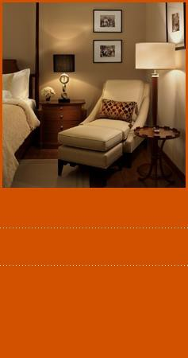

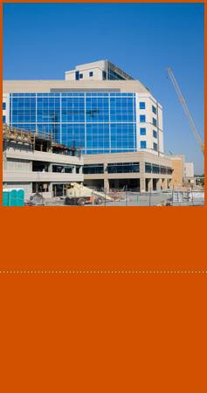

Central Park Projects Spectrum
Residential Projects
Hospitality Projects
SEZ Projects
Hospitality Services
Central Park Golf Course Road
Le Meridien Hotel, Gurgaon
Central Park
Hospitality Services
Central Park Resorts
IT SEZ Project, Noida
Central Park The Room
Aloft Hotel, Aerocity
Delhi
The Room
Central Park Resorts
Central Park Flower Valley
2 Luxury Hotels Coming up in Goa
New Projects

Slide 34
Concept Living boutique landmarks

Slide 35
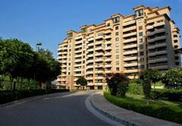
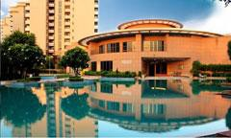
Central Park Golf Course Road
The company's first residential project
Located on the upscale Golf Course Road in
Gurgaon's Sector 42
Set across a 14.5 acre area
Comprises of 407 beautifully designed three and four bedroom apartments and penthouses
Advent of luxurious condominium living in the National Capital Region surrounding Delhi.

Slide 36


Slide 37
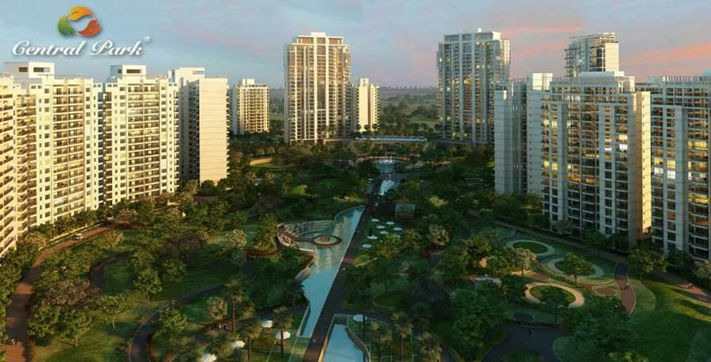
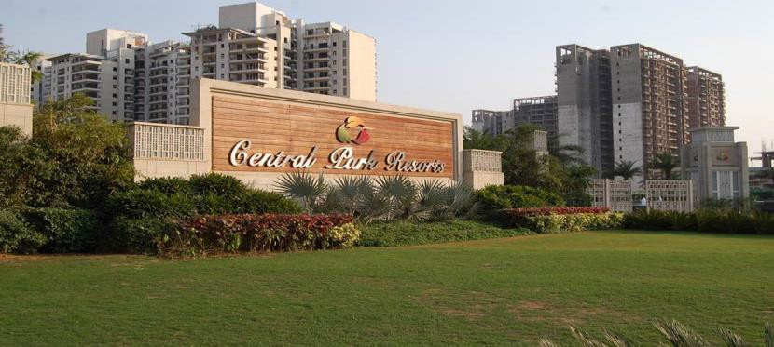
Central Park Resorts
Located at Sector 48 Sohna Road
The Treat- Tunnel underground parking enabling zero traffic movement on ground providing 20 acres of plush green lawns- One of a kind Project
Luxury condominiums spread over 47.5 acres
Over 1706 apartments
27 towers that reach for the sky Beautiful Townhouses & Skyvillas
Master planned by the world's largest architectural
firm-Hellmuth, Obata & Kassabaum (HOK)
International Limited, which has the distinction of master planning the Dubai Marina

Slide 38
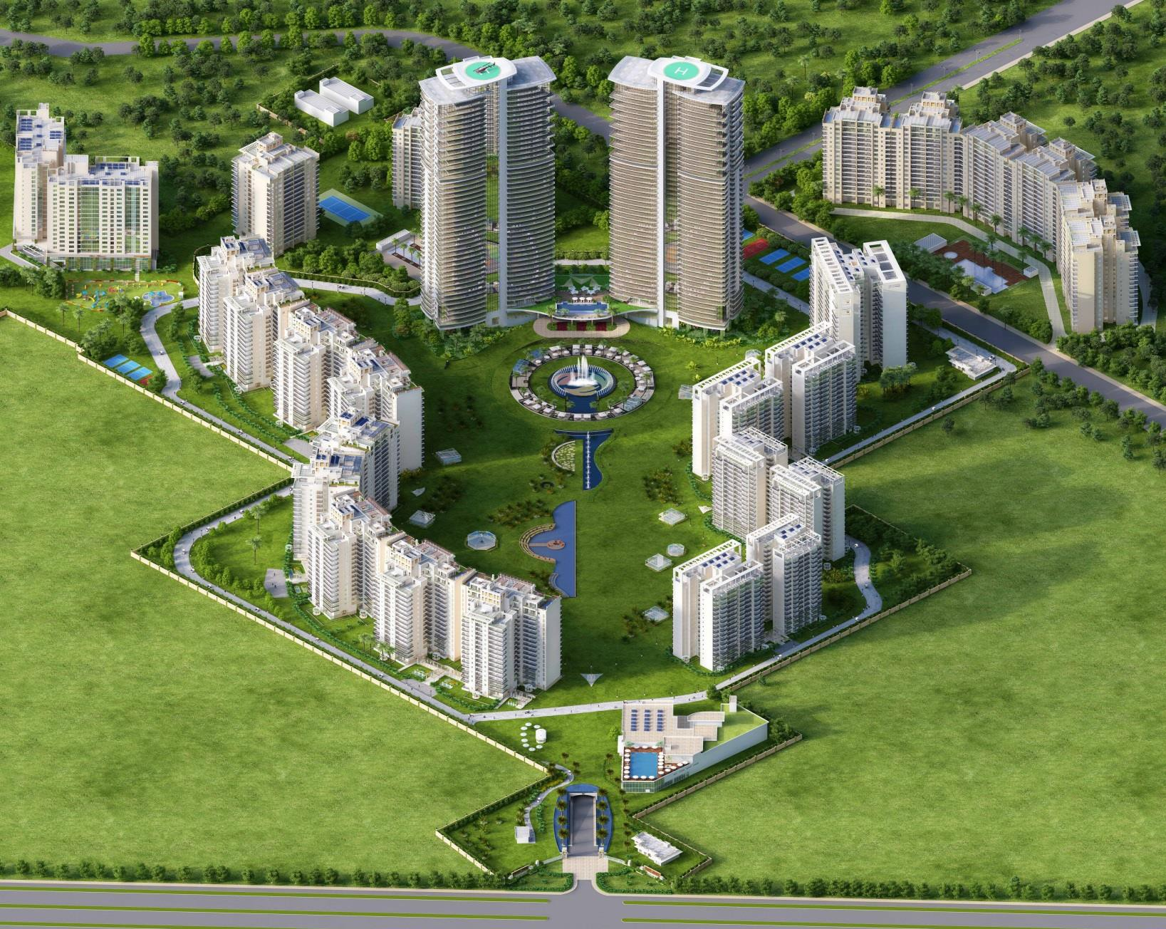
CENTRAL PARK RESORTS
Phase I Bellevue
Phase II Belgravia -3/4 BR
Phase III
Belgravia- 2/3/4 BR
Phase IV Upcoming
The Room – Studio 1BR/ 1 BR + Study

Slide 39
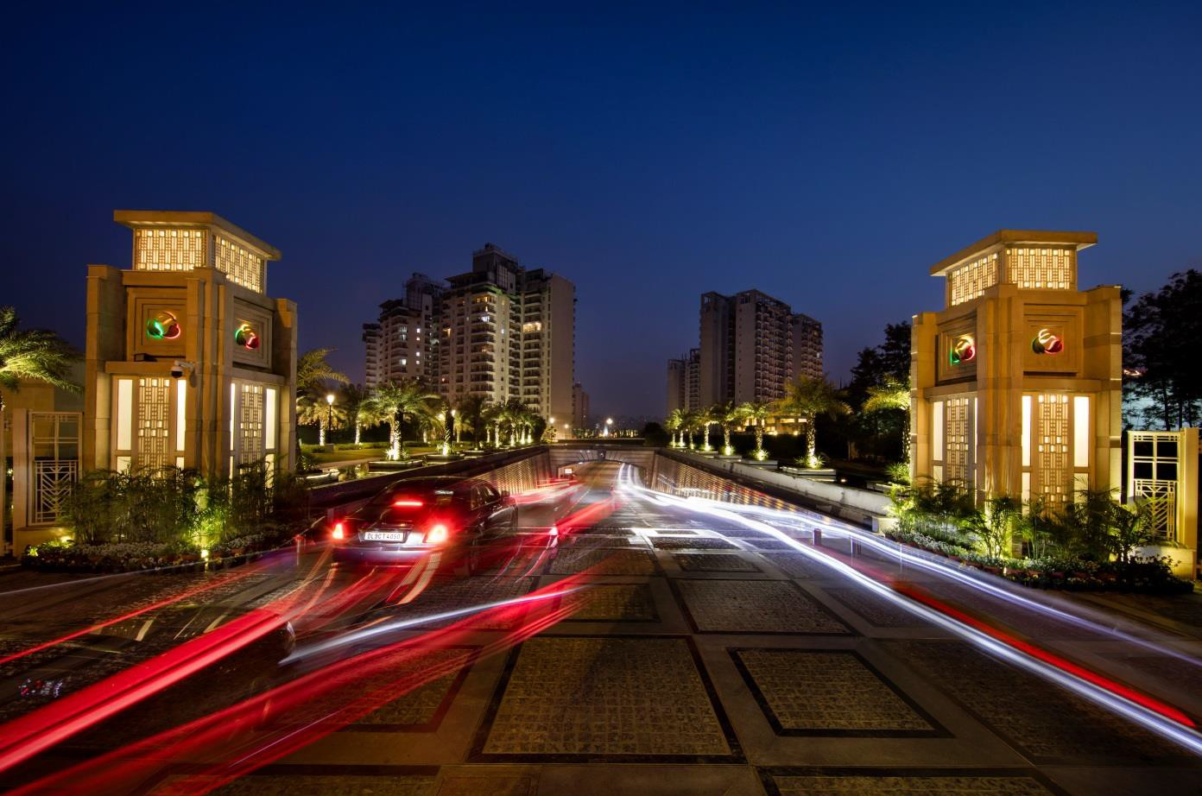
Tunnel- The Treat

Slide 40

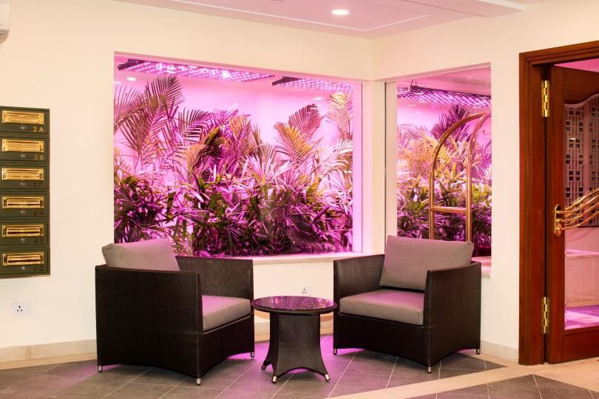

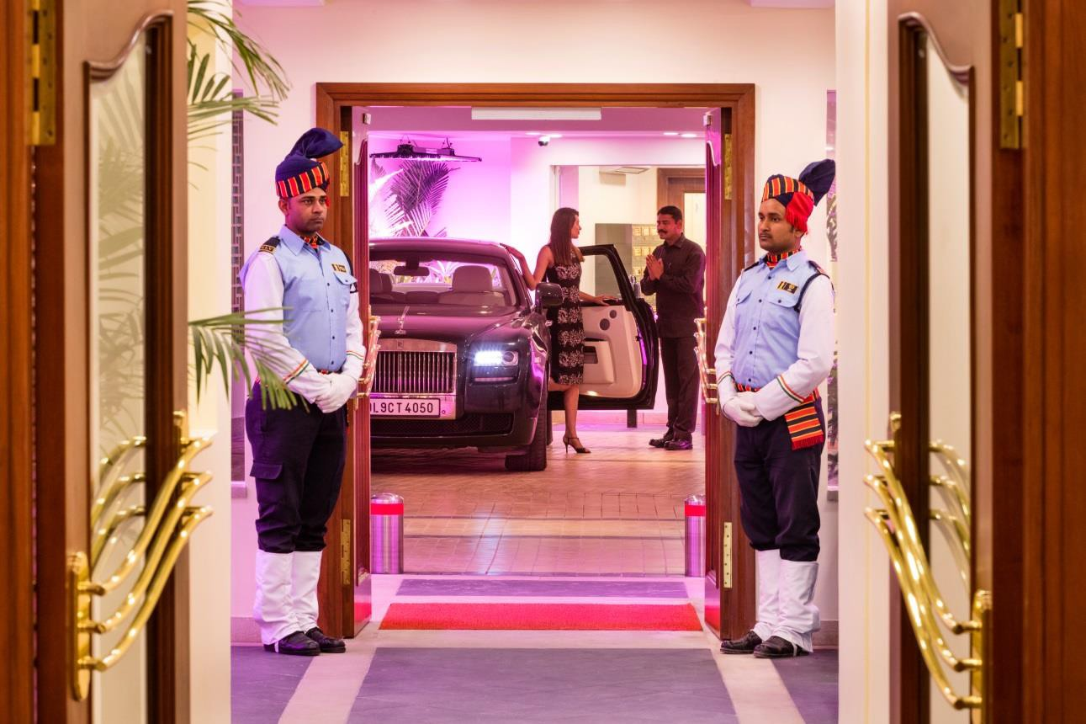

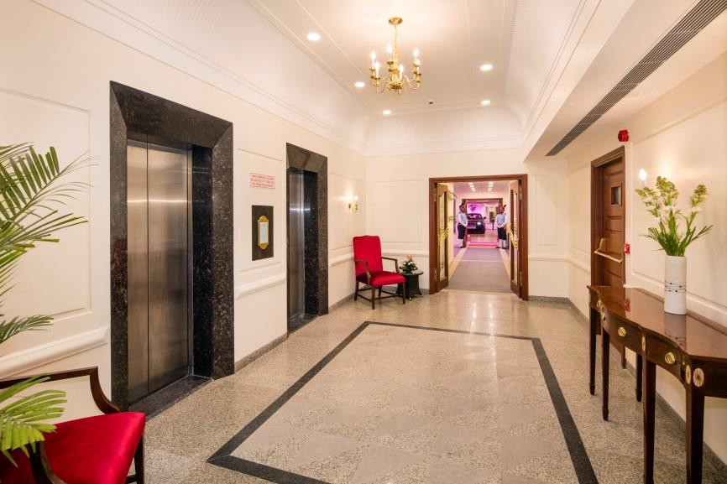
Arrive at Air Conditioned Drop off Points

Slide 41
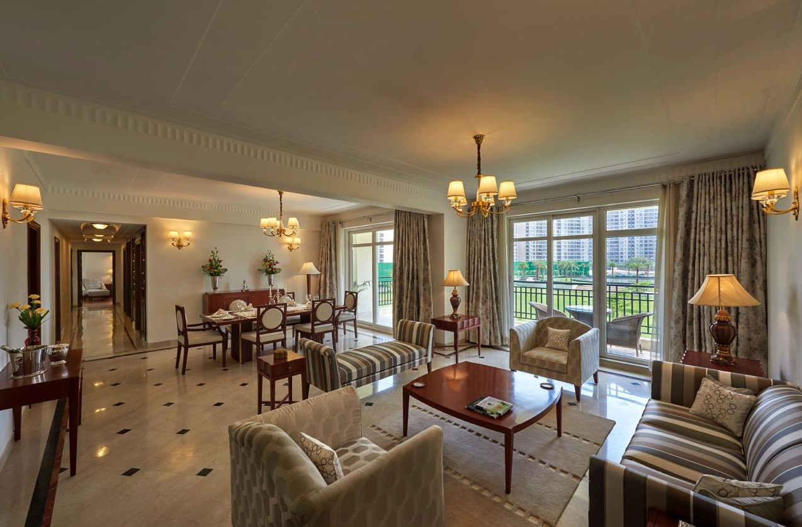
Inside a Belgravia Apartment

Slide 42

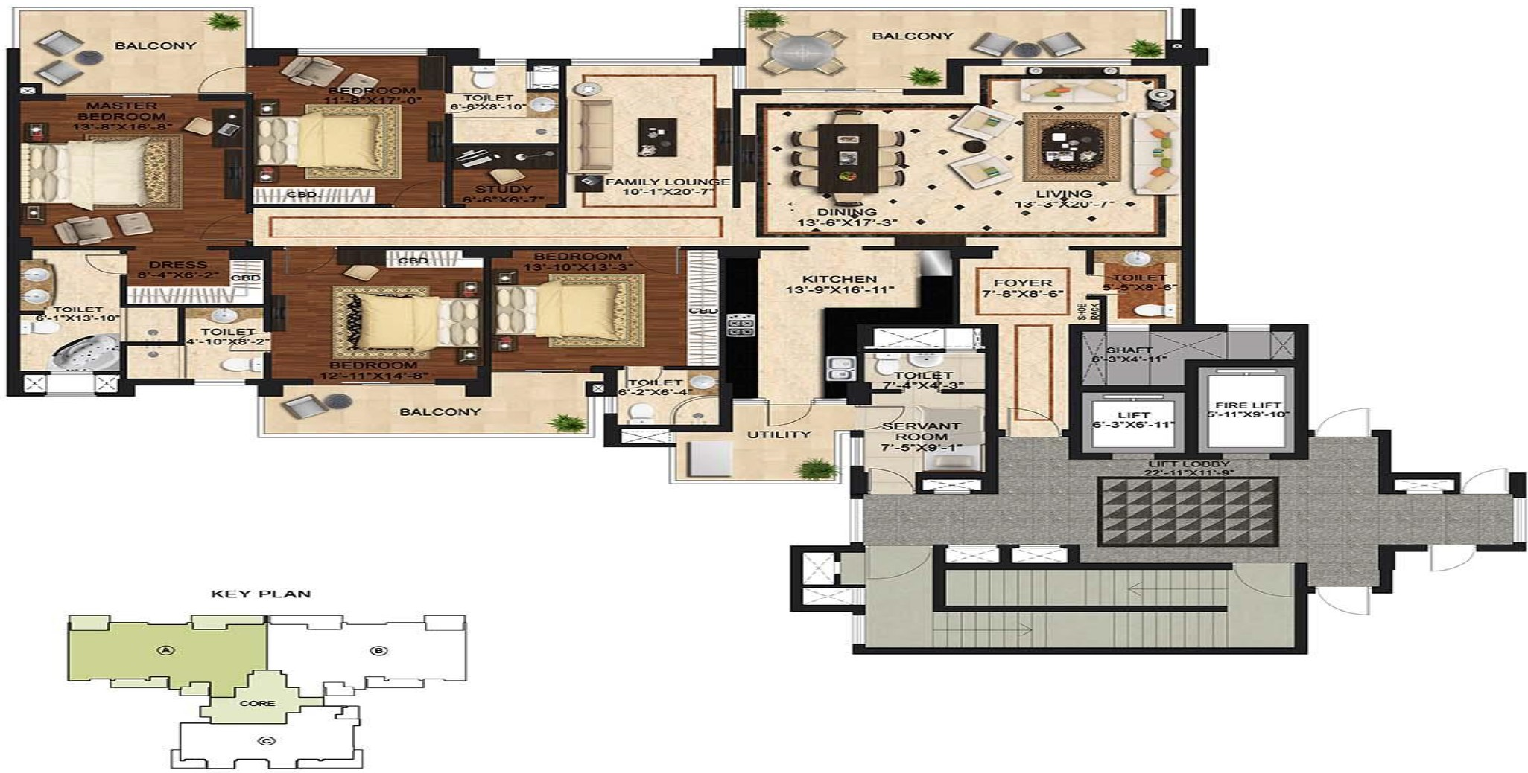
TOVVER. C TYPE A.
TYPICAL APARTMENT
Super Area - 393 1 Sq_ Ft_
UNIT
---·expect the vvo rl d ----
008

Slide 43

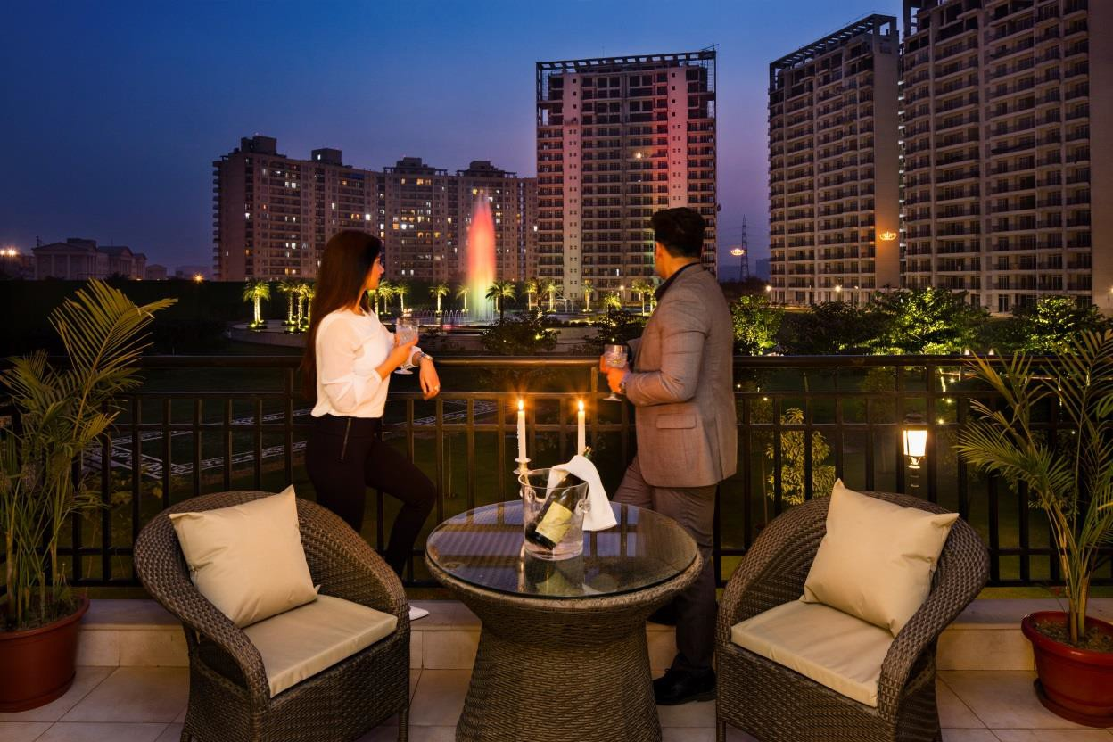

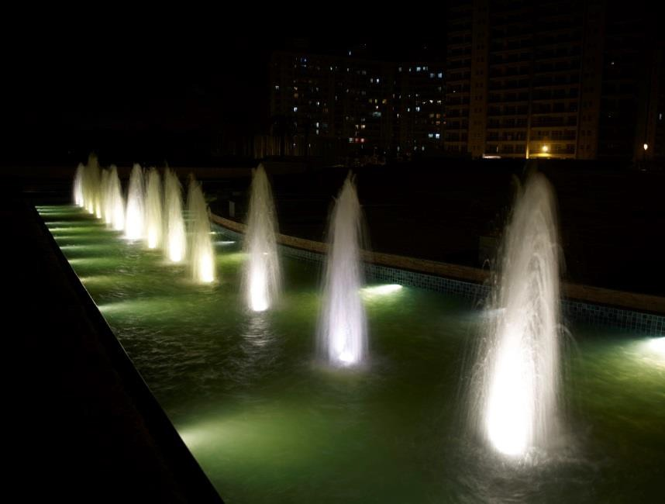

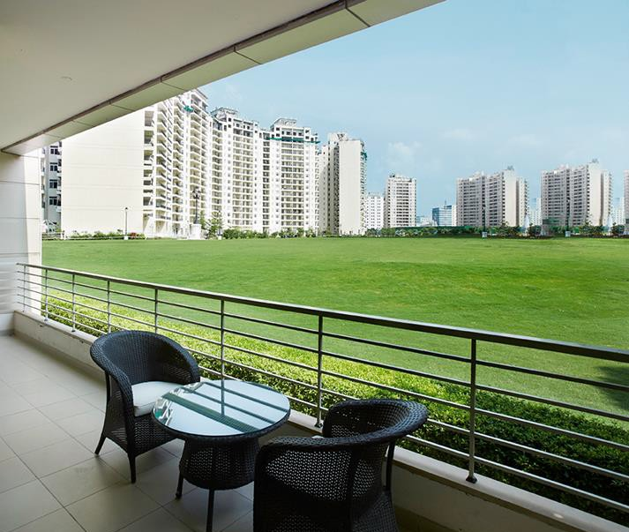

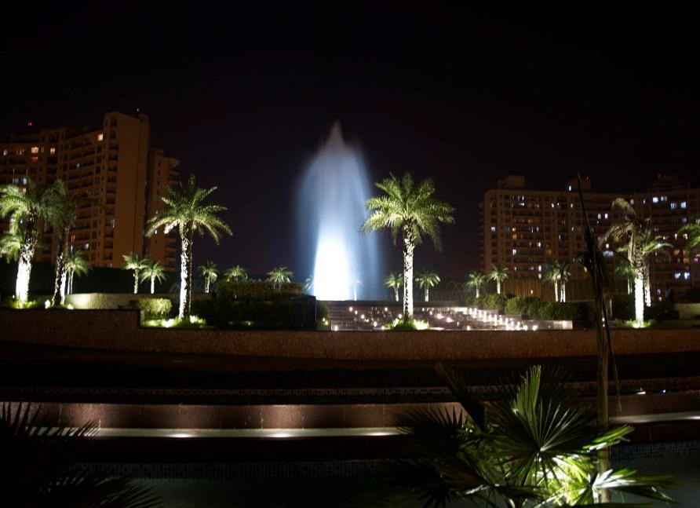
View from the Balcony

Slide 44
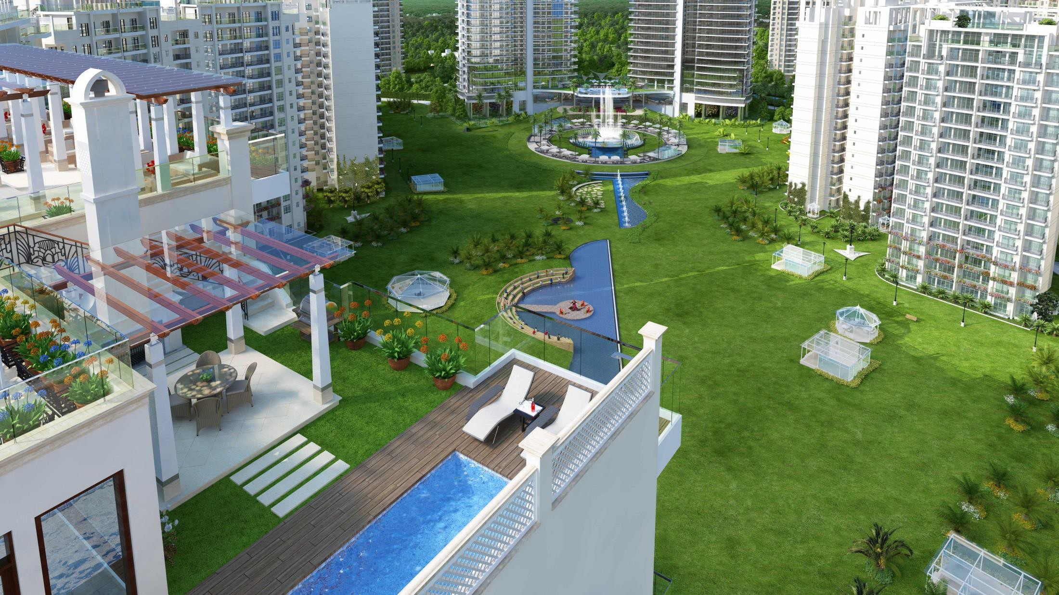
Sky Villas at Central Park Resorts

Slide 45
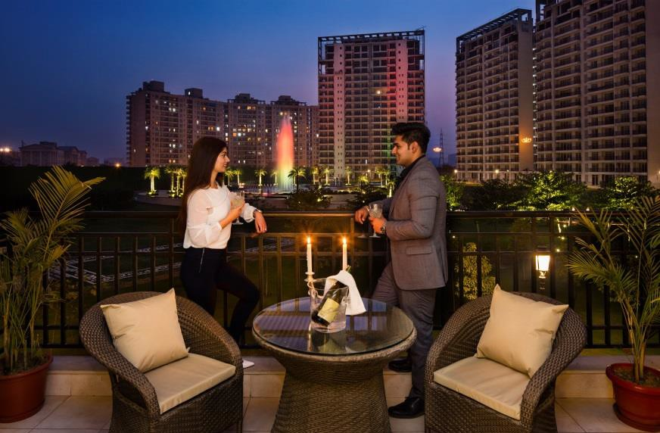
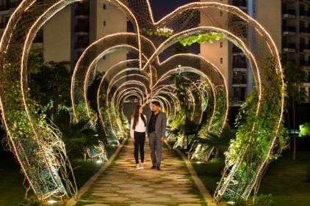
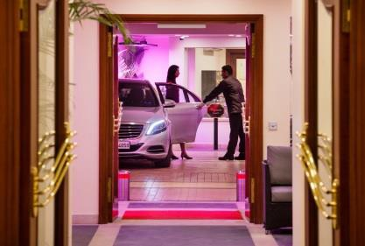
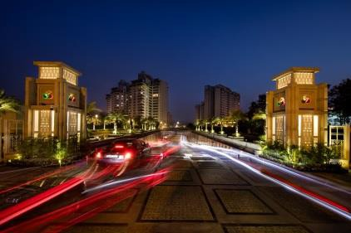

Central Park Resorts – Resort Residences
Unique proposition of living in a resort
Gorgeous, expansive undulating greens dotted by water bodies and fountains
Drive to your apartment through a stunning tunnel experience
Get off at ‘drop- offs’ that resemble luxury hotel lobbies complete with a bell boy to transfer your bags
Large balconies and sit outs offer you spectacular views under the sun and the star spangled sky
Plenty of recreation activities
18000 sq. ft. of dedicated children play area and more
5 Star Resort services like concierge, housekeeping, laundry, business centre, guest
houses, among others

Slide 46

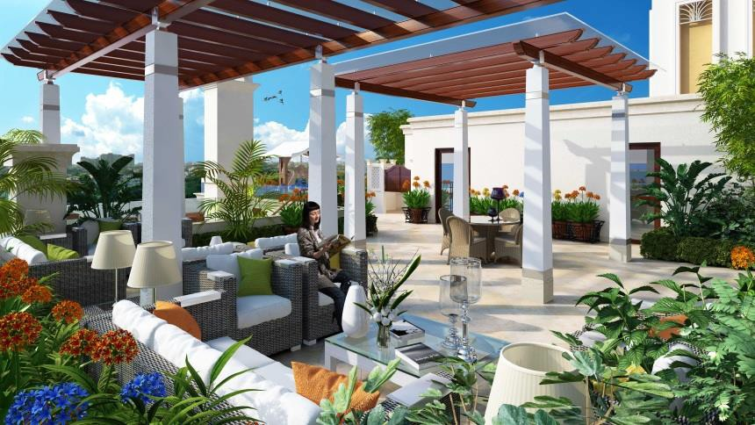
Central Park Resorts – SkyVillas & Town Houses
Sky Villas – Penthouses in a Resort
  Located on the topmost, 16th floor
  Perfectly suited for those who enjoy living the high life close to a busy city centre
  It's a combination of lavishness, privacy and high-
end amenities
  Indulge in luxurious desires like having a splash in your personal pool
  Or enjoy a party in the terrace garden
Town Houses
  Spaces on the Ground Floor that come with a stamp of class and refinement
  Spacious and elegant
  Designed to be exceptional homes that exude
excellent craftsmanship and sophistication
  Designed for the privileged few
  14-feet high ceilings, spacious areas and grand interiors
  Set amidst lush green landscapes
  Equipped with every feature befitting a luxurious modern residence

Slide 47

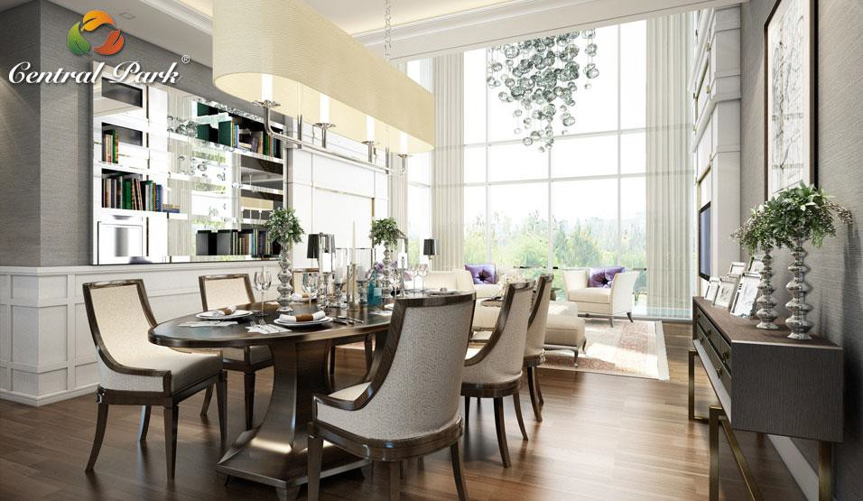
Townhouses at Central Park Resorts

Slide 48

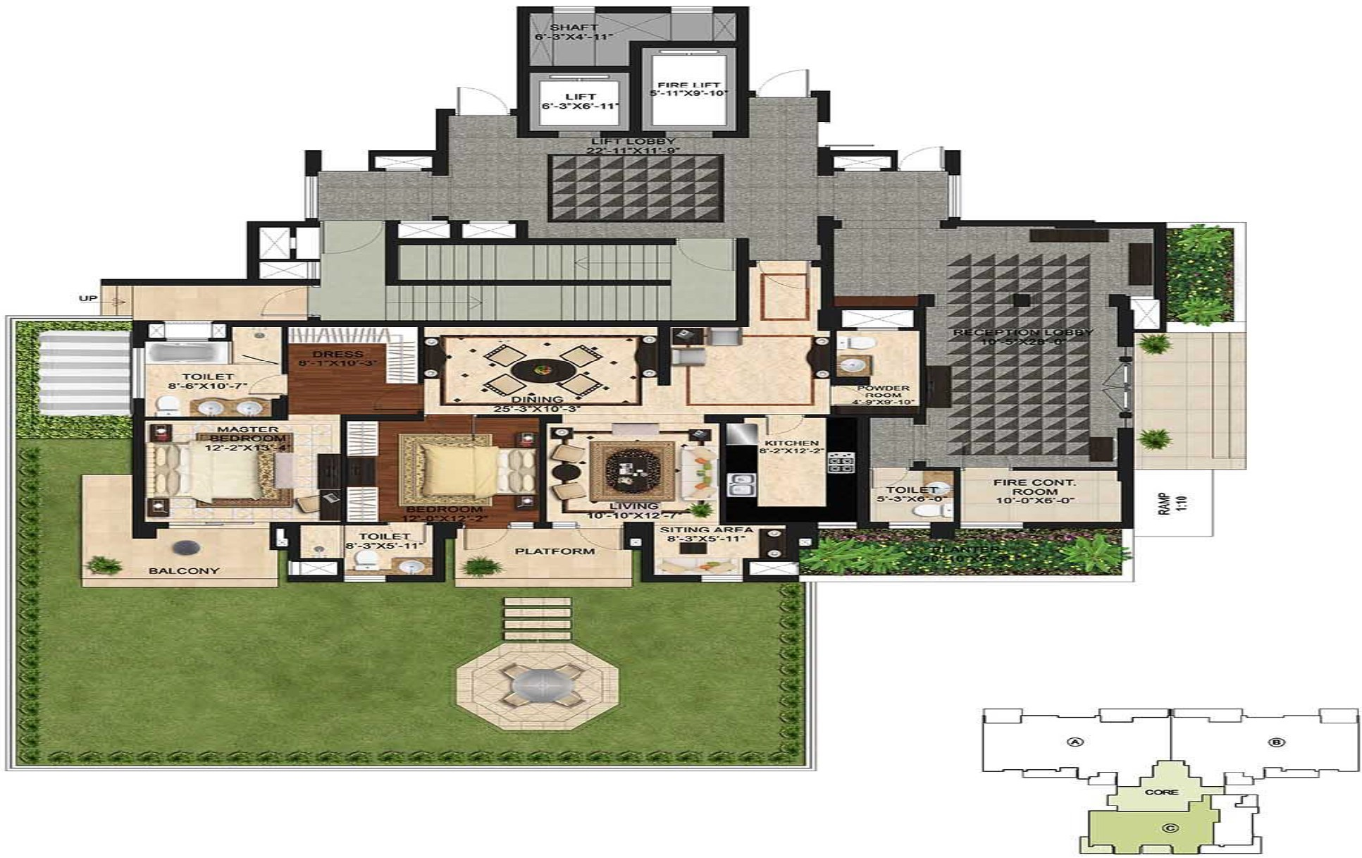
TOVVER. A TYPE C TOVVN HOUSE
Super Area - 1929 Sq. Ft:.
--ex pect th e vvo rl d ---
0"12

Slide 49


Slide 50
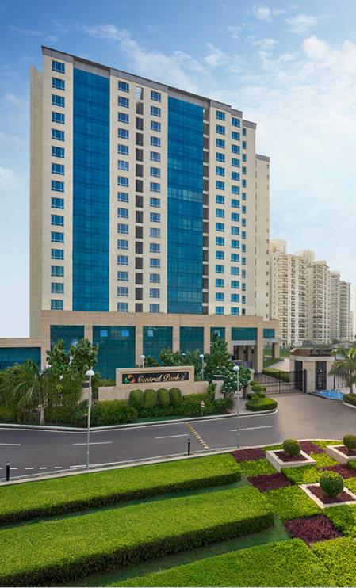
Our Delivered –
Most ‘in news’ landmark on Sohna Road
Fully Serviced Studios
Ultra Luxury Interiors
24/7 Concierge Services
25000 sq. ft. Clubhouse
Highest Capital Appreciation
Over 90% Occupancy
Over 100 expats
Rental Assistance Helpline
More Rental than a 3BHK
In-demand Property

Slide 51
The landmark Rentals
The Room Pre Leased Model
Property | 16/17/18 Floors | Units | 51
No. of Towers | Wing 1 & Wing 2 | Type of Units | Ultra Luxury
No. of Units Per Floor | 9 Units Per Floor Per Wing | Specifications | Fully Loaded
Opening Price (INR) | Studio Unit | 14220/= PSF * Sold Out
 | 1 Bed Room Unit | 14220/= PSF * Sold Out
 | 1 Bed Room + Study | 14716/= PSF
Assured Rental | Rs. 75 Per Square Feet
Rent Revision | @15% every 3 years

Slide 52
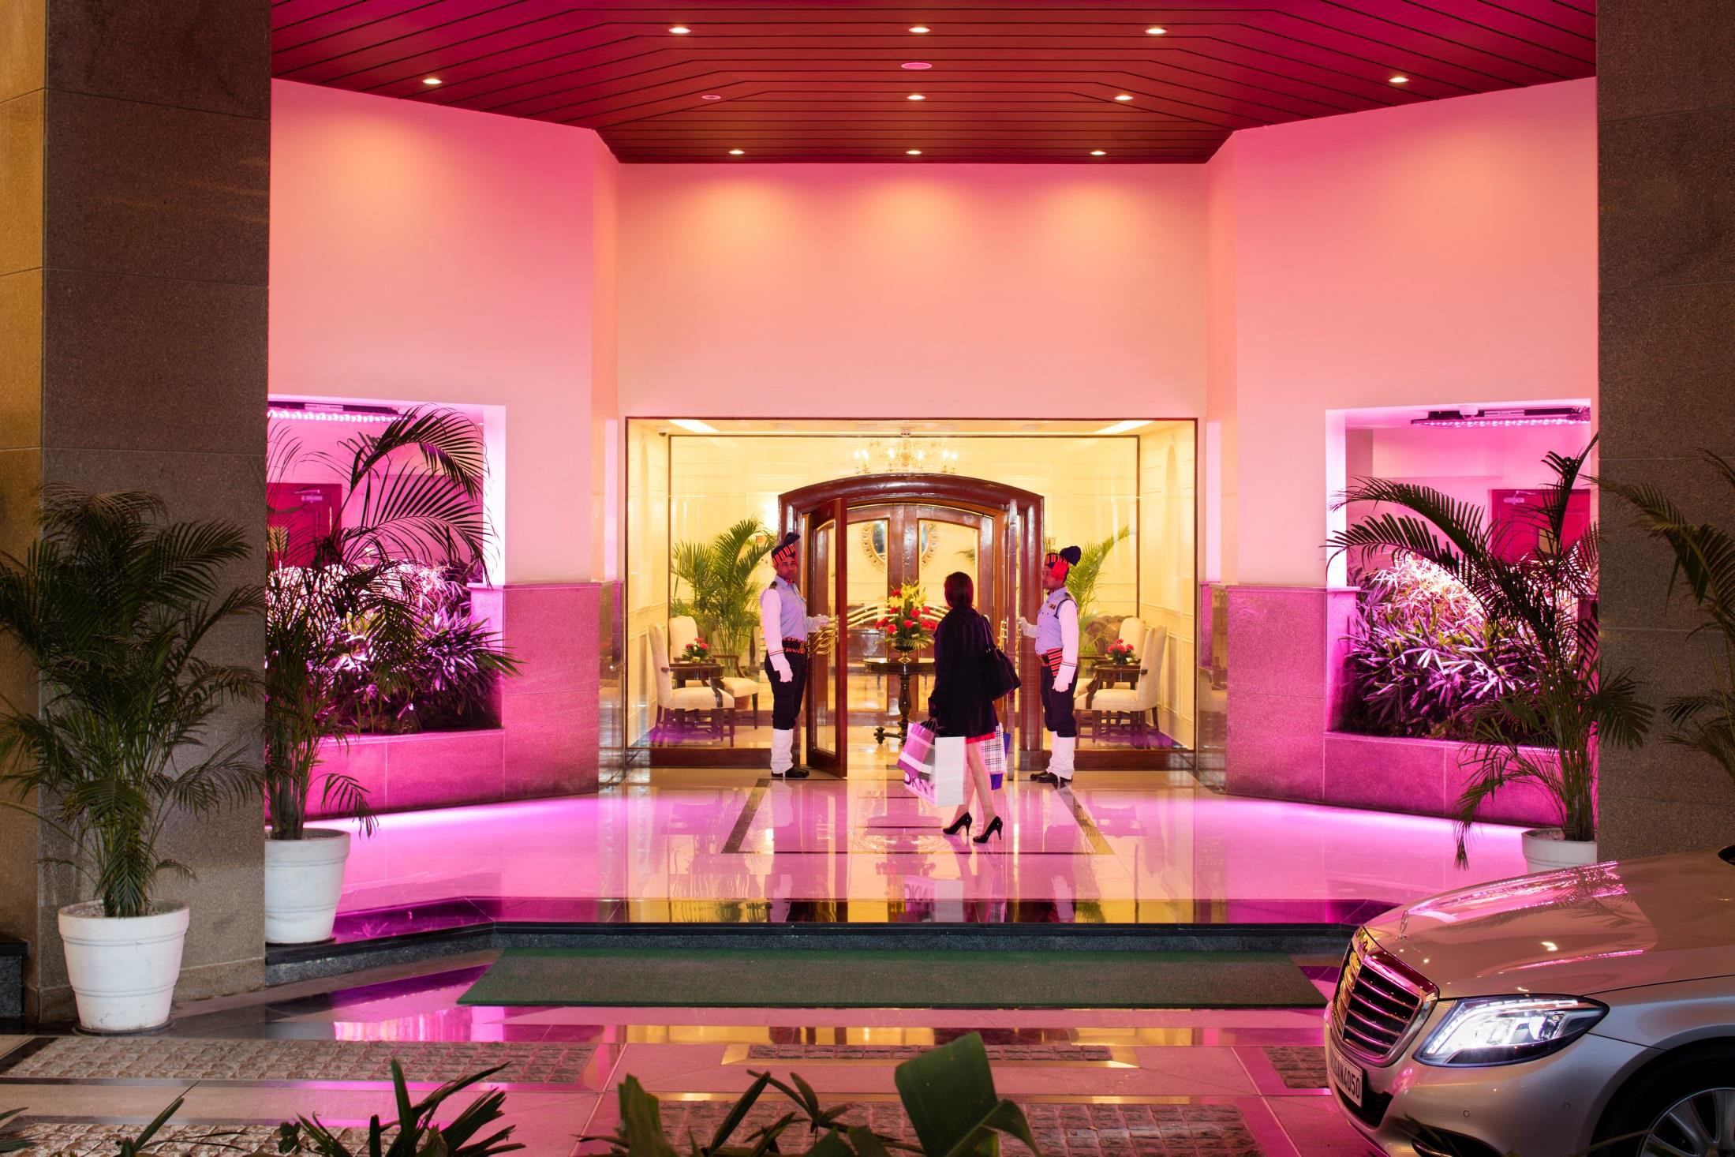
Enter a new world, a new concept of living

Slide 53
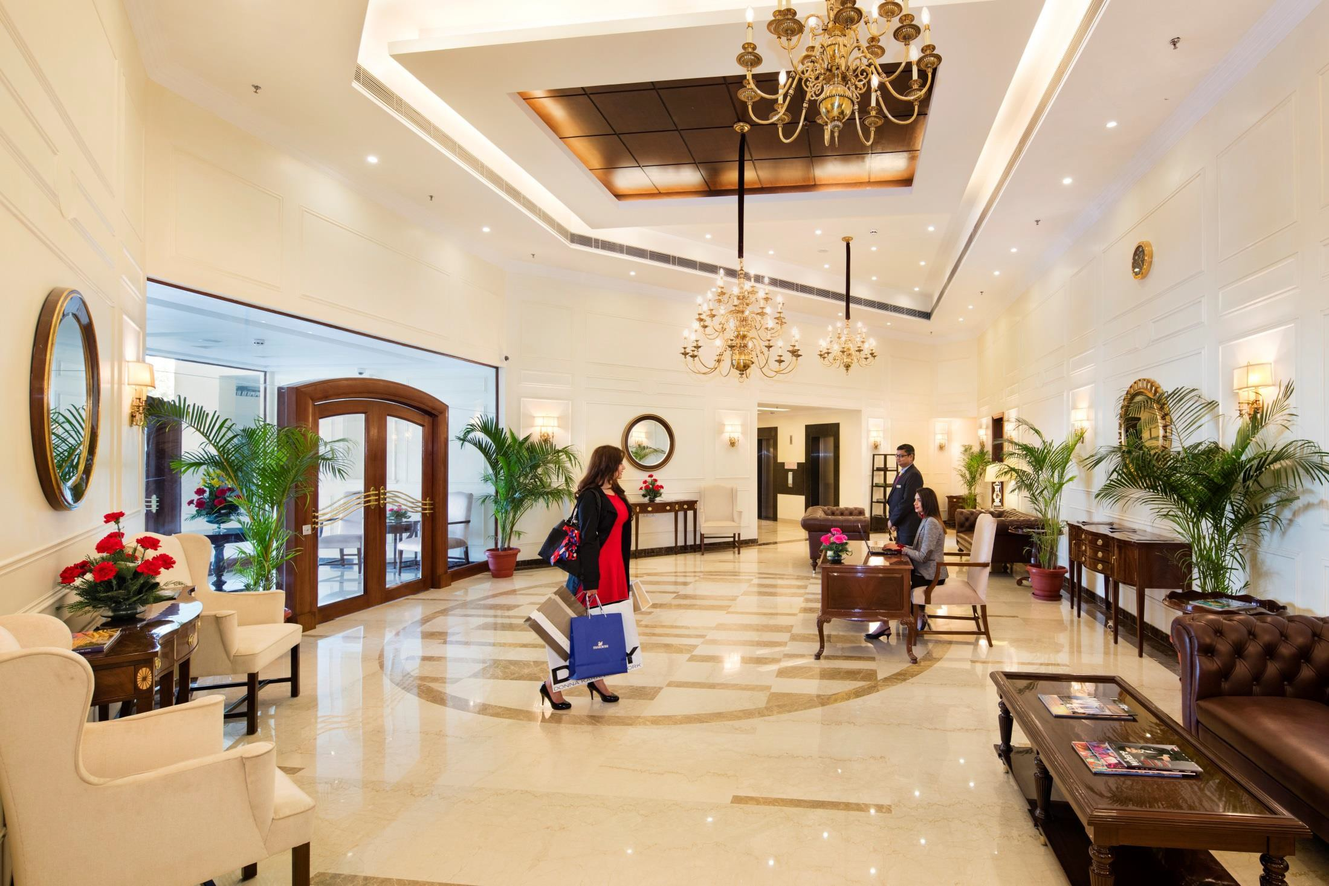
5 Star Lobby

Slide 54

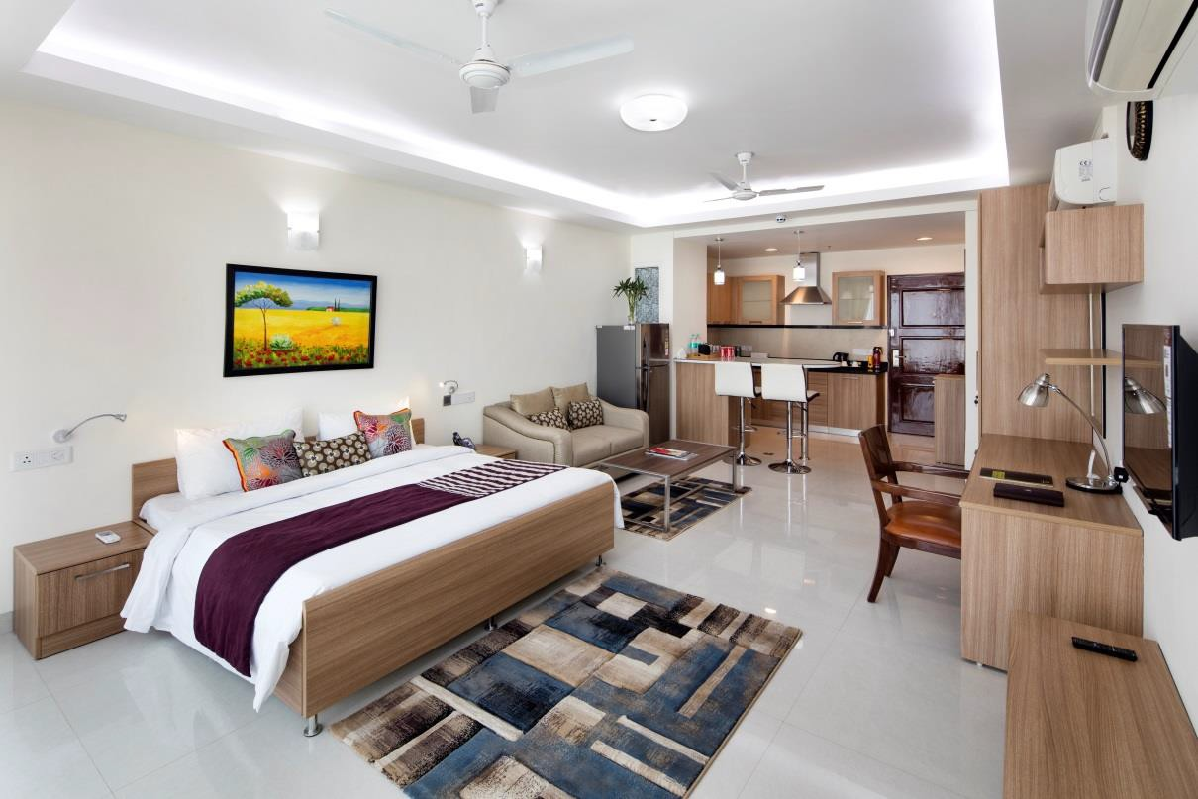

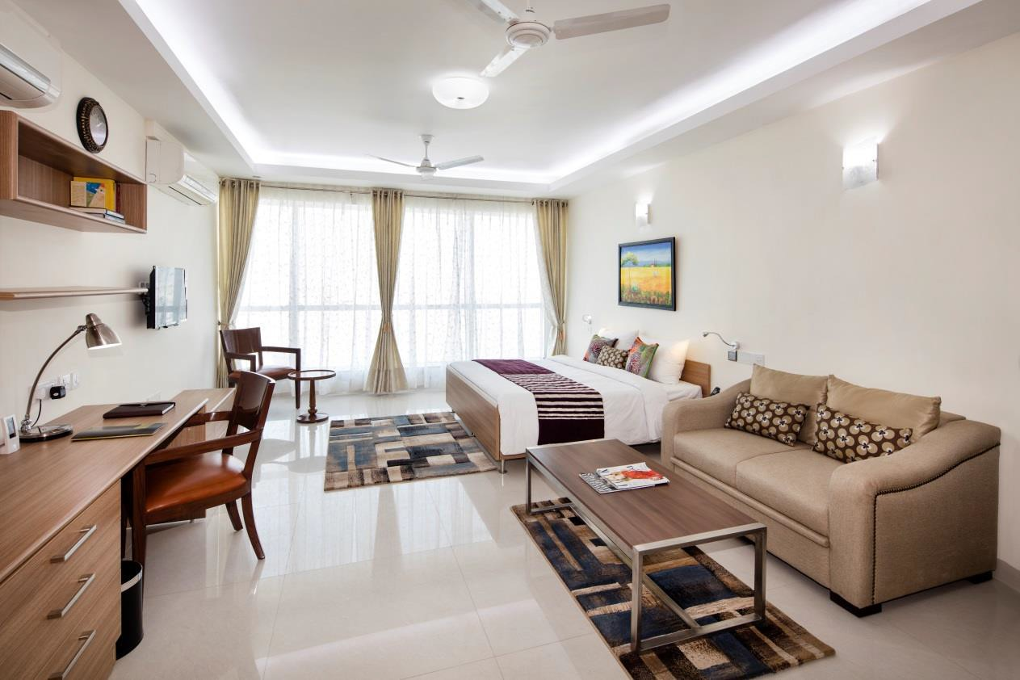
Fully serviced living

Slide 55
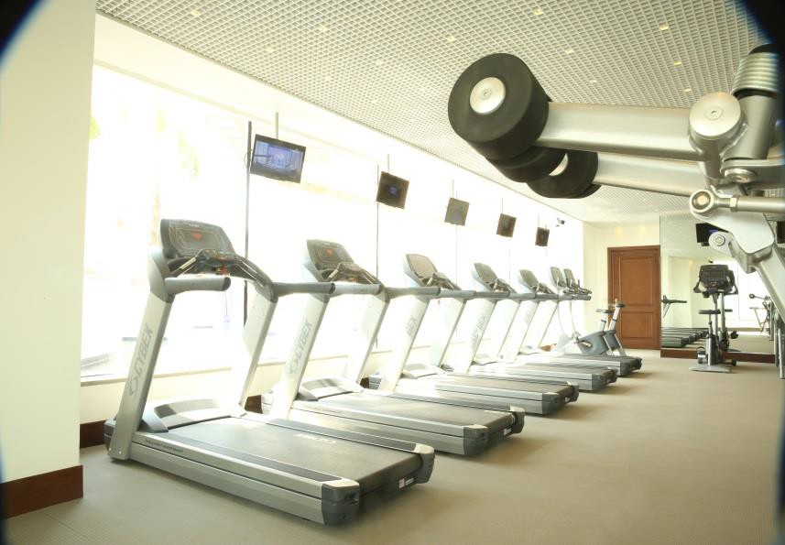
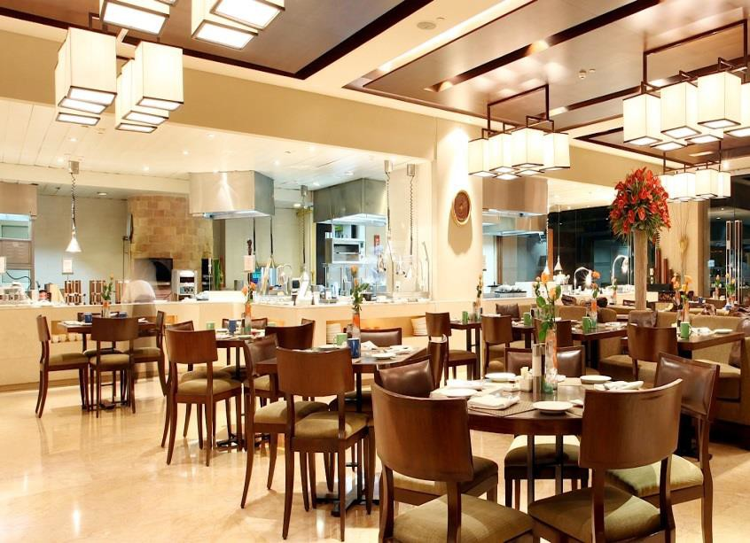
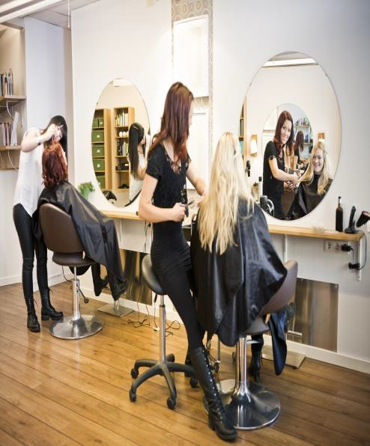
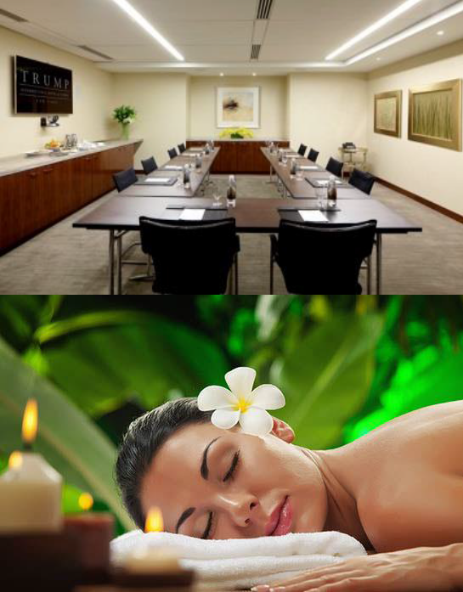
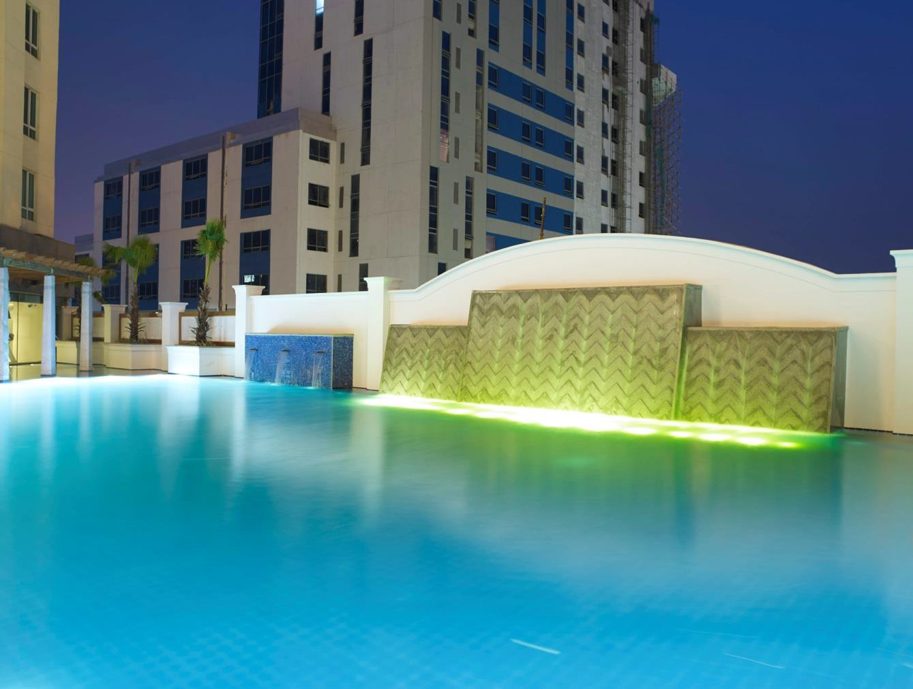
A club like no other

Slide 56
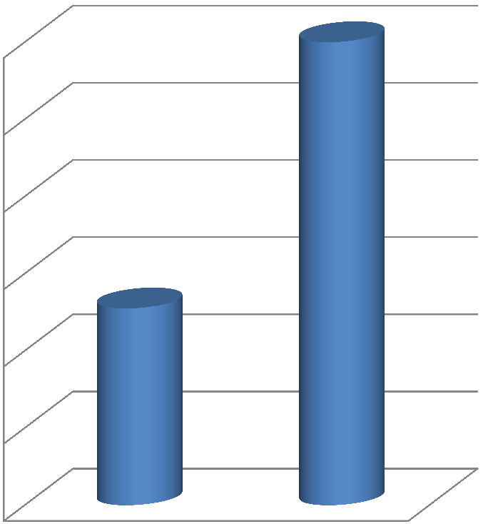

The Room- Our Successful Concept of Fully
Serviced Apartments with Maruti deal
Price
12000
15820*
Highest Capital Appreciation
10000
8000
Highest Rental Yield of
over 6%
6000
5500*
4000
Plans to Build The Room in different Cities
2000
0
2010
Y
015
2010
2 2016
ear

Slide 57


Our new Concept– Central Park Flower Valley
Sector 32, 33 South of Gurgaon

Slide 58
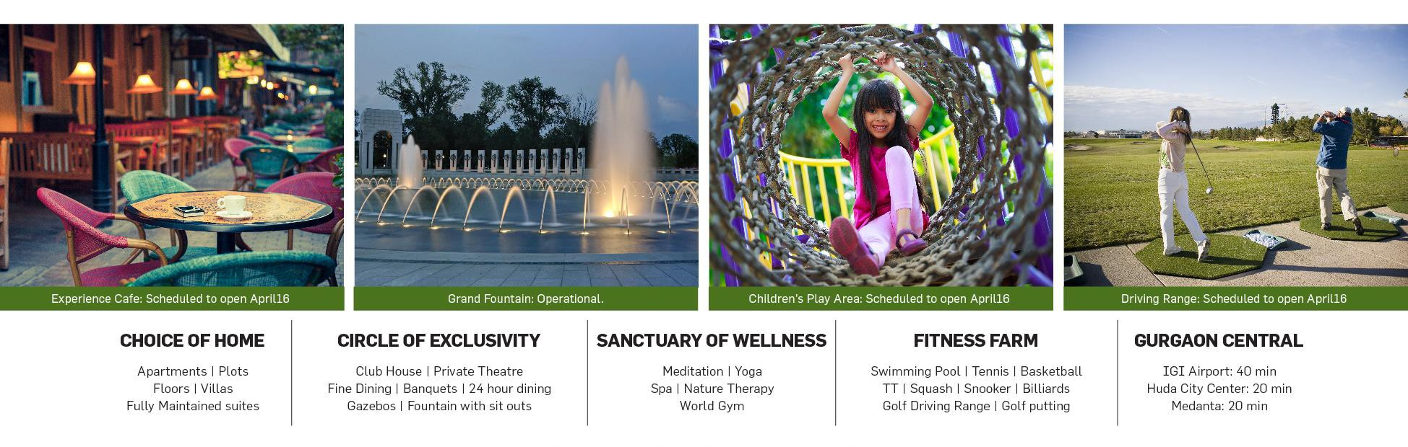
Welcome the 360⁰ living experience only
at Central Park Flower Valley

Slide 59


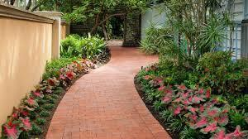

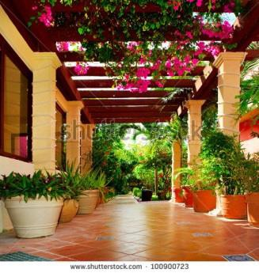
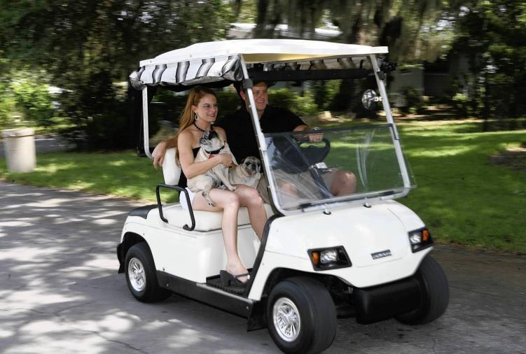


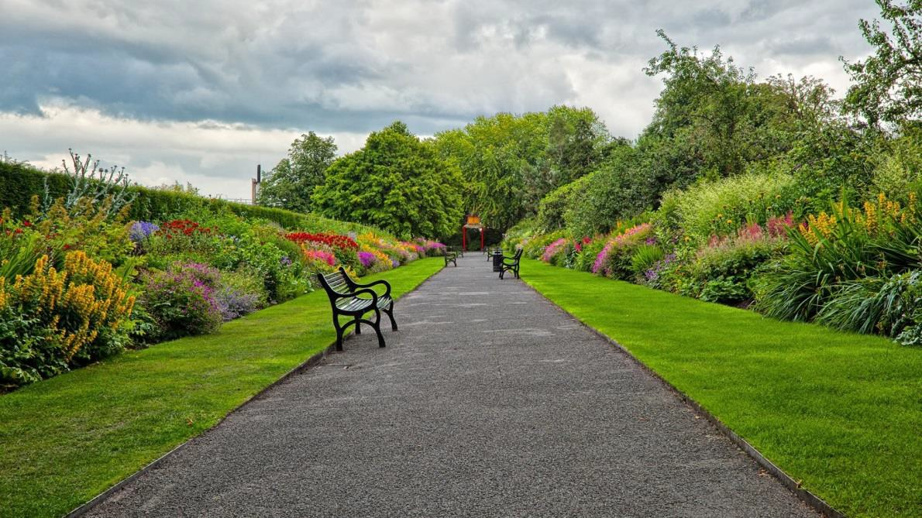
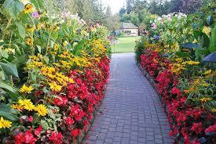
A most, premium, prestigious
township

Slide 60



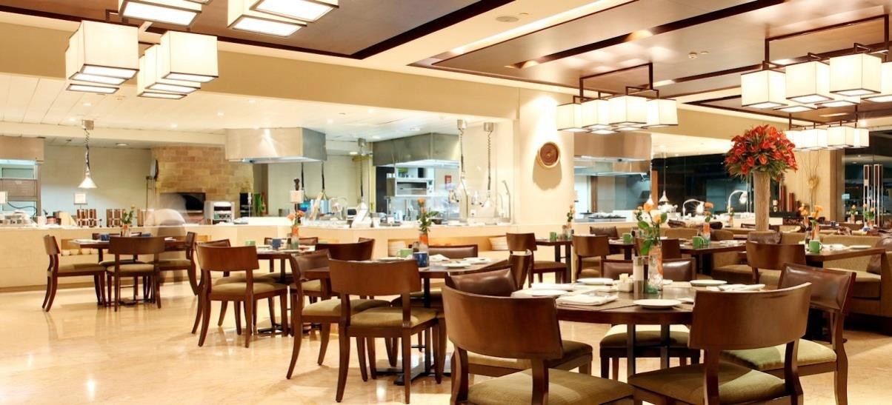

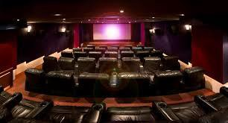

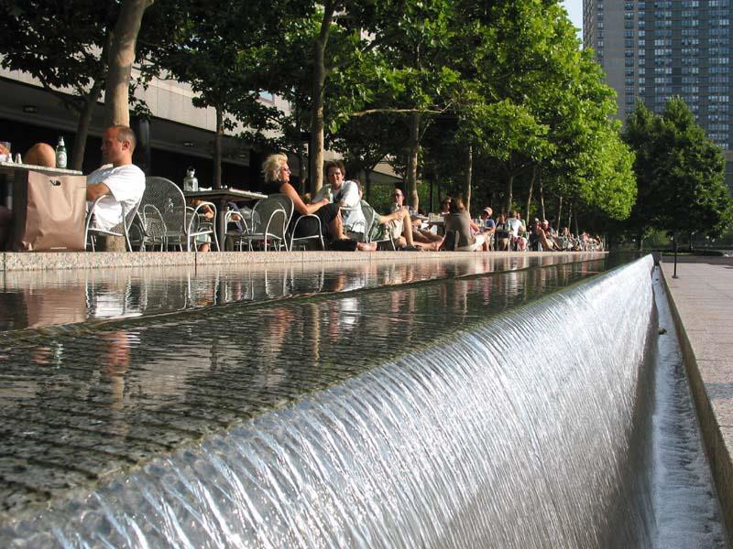

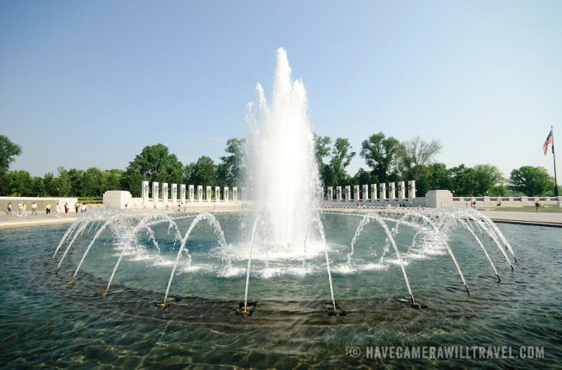
Circle of exclusivity:
Club House
Fine Dining Gazebos Experience Café Private Theatre Fountain with sitouts

Slide 61












Exclusive Amenities: Fitness Farm

Slide 62










Wellness Sanctuary

Slide 63






Social Networking

Slide 64


I. ENTRANCEPI.AZA
+--+--i 'f:
.41-'::::=-+--+------, : :lANE
f-...., !+-::-+---'
EfHS
GUEST TOILETS
GRAND FOUNTAIN
10.EXPERENCE ·MUlTI CU$N:RESTAURANT
f-----.--f-f--::-l----1 II.ClU&- flOWER VAllEY
r---.-+--4--,--...j : := y
f--, +--+ =---1 :!
12!OXI'IGACADEMY
PAAK
17.ENJOY·CitlOREN'SWATERPARt::
18.BASKET &AllCOURT
19.GOU'PUTllNGGRE&IS
GREENS
f- ,=f-f-:':--1-=---
'-'----'-=--_j 22.GOlf ACADEMY
23.GOlf DRIVING RANGE
24.GAZSO SNACK BAR
25.fl0WERLANE
26.FlOWER lANE
'0.LAWN 'I'ENNS ACADEMY
28.CRiCKET ACADEMY
29.CAlY NEEO SHOPS • KIOSKS
;nSENIQf!: QnzEN COURT
31.flOWER LANE
32.FLOWERLANE
33.MUANOV!Gfi'A&I...E800TH
NURSERY SCHOOl
NUR:SNG HOME
36.TAXIST.......,
37.PRIMARY SCHOOl..
38.FLOWER lANE
39.flOWER LANE
40.flOWER LANE
41.fl0WER8ID
.¢AMPHITHEATER
.O.ZEN GARDEN
. .P,.t..K VIEW GAZEBO
45.8A.OMINTON COURT
46. 8AOMINTON ACADEMY
47.Fl0WERI.ANE
-48.FLOWER lANE
4?.YOG..VMEOrTAlK)N COURT
.50.FLOWER LANE
5L VICTORWI GARDEN
52flOWER
53.flOWER lANE
54.FLOWER LANE
55.FlOWER LANE
56.CRfCHE S7.flOWER lANE 58.FLOWER LANE
5'/.flOWER I.ANE
60.FlOWER LANE
61.Fl0WERLANE
FLOWER LANE
REliGIOUS BUilDING
64.Fl0WERI.ANE
65.FlOWER LANE
66.Fl0WERI.ANE
67.ROWERLANE
68.ROWER LANE
69.fl0WERI.ANE
70.HIGH SCHOOl
71.FLOWER MIJSSJM
SECTOR-32
.t sow.sHCOuttl
n.FLOWER LANE
73.DISPENSARY
74.COMMERCIAL COMPlEX
75.'0-IEROOM
76.LAKE FRONT TOWERS
n.n-tE LAKE
78.CLU8·THEROOM
79.1NRNTYPOOl
BO.KIO'SPOOl
81.NURSERYSCHOOl·THE ROOM
82.VIlAS·250 SQ.YAROS.
83.VUAS ·300SQ.YAROS.
SA.FlOWER lANE
85.FLOWER LANE
86.A.OORS·I80SQ.YAROS.
87.A.OWER lANE
88.FLOWERI.ANE
89.A.OORS·193SQ.YAAOS.
90.FlOWER LANE
'^{l.I}"^{AA}"^{I.}"^{Et&}"^{lf}"^{oiG}'"""
•toW\JNoGioJ.lEY
'N0cr""
&.LOUV lOONGE 1MI.A. -l
l..SI'ECWJI'I'IHSI...utNtl
f leltAA'I'MACIING!tOOM
IO.CAAOS
:i
1). IOOOlOOI"'OX
I•IV.l.Ot.tKOf:/,...I IRE
::= ltQOM.SI[M lA\INAfACUII6
15. 11Al01'fSHOf'
I... J\OIISISHOf'
19 a&.uf'IWOH
XI.CY
:I'I.VOC.O.IIOOM
2?.0ANCI'IIOOM
23.ICANOl·.... AND 0GC0 11-f:auE
:1'• D.o.NCEACAOfMY
g!Q...... GIAN P. MATHUR & ASSOCIATE (P) LTD.
CENTRAL PARK- FLOWER VALLEY
SITE PLAN
I".. ARCHITECTS,ENGINEERS AND PLANNER

Slide 65
The Villas

Slide 66


Slide 67


Slide 68
Key Highlights of The Villas | Details
Concept | Luxurious Expandable Villas
Master Planner | To be disclosed
Sizes | 250/300/375/400/500
Specifications | Luxury
No. of Villas | 14 launched currently in Phase 1
3 Bedroom + Servant Villa | 250 sq yds- 2919 sq. ft. Built up expandable 250 sq. yds- 4502 sq. ft. Fully Built up with Lift
Booking Amount | Rs. 15 lacs
Price | Rs. 2.19 Cr BSP (PLP 35:65) for 2919 sq. ft.
Club Membership | Rs. 3,50,000
Power Backup | 100 %
Key Project Features
Ultra Luxury Villas at Flower Valley
Expandable Villas – All East Facing
Located on Prime Sector Road (60 Mts wide)
World Class Clubhouse
Golf Academy
Walking lanes by Fountain
Part of 500 acres prestigious township

Slide 69
Proposed Villas At Flower Valley - Specifications
AREA | LOCATION | SPECIFICATIONS
Living / Dining | Flooring | Superior quality Imported Stone/High quality designer vitrified tiles
 | Wall | Plastic Emulsion Paint
 | Ceiling | Plastic Emulsion Paint
Bedrooms | Flooring | Laminated wooden flooring
 | Wall | Plastic Emulsion Paint
 | Wardrobes | Wardrobes in all Bedrooms
 | Ceiling | Plastic Emulsion Paint
Kitchen | Flooring | High quality vitrified tiles
 | Kitchen | Premium CP fittings, Exhaust fan, Geyser
 | Wall | Tiles upto 2 Ft above the counter & rest Plastic Emulsion Paint
 | Ceiling | Plastic Emulsion Paint
 | Appliances | Refrigerator
 | Cabinets | Modular Kitchen With Chimney & Hob
Toilets | Flooring | Anti skid ceramic tiles
 | Wall | High quality designer ceramic tiles
 | CP Fittings | Jaguar, Kohler or equivalent
 | Sanitaryware
 | Ceiling | False ceiling/ Plastic emulsion paint
Balcony | Flooring | High quality anti skid ceramic tiles
 | Wall | Weather Proof External Texture Paint
 | Balcony Railing | Glass / SS /MS railing as per Elevation
Staircase | Flooring | Marble / Granite Flooring
 | Railing | SS / Glass / MS Railing with Wooden / SS Handrail
General | Split Air Conditioning | Split Air Conditioners in all Bedrooms & Living Dining
 | Main Door | Hardwood Door Frames, Veneered Shutter (Both sides)
 | Internal Doors | Hardwood Door Frames, Moulded panel/ Flush door Shutters
 | External Doors and Windows | UPVC Door Windows, 5mm Toughened Glass
 | High Quality Modular Switches | North-West or Equivalent
* Rs 1200000/- Will be charged Extra for installation of Branded Elevators like OTIS with Minimum 3 Stops.

Slide 70
Lake Front Towers

Slide 71
 | Key Highlights of Apartments | Details
▪ | Concept | Lake Front Towers
▪ | Master Planner | To be disclosed
▪ | Sizes | 1590 Sq. ft. – 3BHK 2407 Sq. ft.- 4BHK + Servant
▪ | Specifications – 2 Types | Bareshell / Luxury
▪ | No. of Floors | G + 14
▪ | Booking Amount | Rs. 5 lacs – 3 BHK / Rs. 7 lacs – 4 BHK
▪ | Price - Customize Your Own Home (Bareshell) | Rs. 5100 per sq. ft. BSP (Inaugral Discount Rs 200) PLP
▪ | Price - Luxury Specifications | Rs. 6000 per sq. ft. BSP (Inaugral Discount Rs 500) PLP
▪ | Car Parking | Rs. 3,00,000 (Optional)
▪ | Club Membership | Rs. 3,50,000 (Optional)
Key Project Features Very Efficient Plans with 80 % Open areas
▪ | Balconies with each Bedroom
▪ | World Class Clubhouse for residents
▪ | Walking distance from Golf Range

Slide 72
Price List - Lake Front Towers at Flower Valley, South Of Gurgaon
S.No | Area (Sq.ft) | Type | Down Payment Plan | Construction Linked Plan | Flexi Payment Plan (35:30:35) | Possession Linked Plan (35:65) | Subvention Plan (15:80:05)
1 | 1590 | 3 BHK | 6412470 | 7286970 | 7846650 | 8109000 | 8407920
Inaugural Discount |  |  | 318000 | 318000 | 318000 | 318000 | 318000
Net BSP |  |  | 6094470 | 6968970 | 7528650 | 7791000 | 8089920
S.No | Area (Sq.ft) | Type | Down Payment Plan | Construction Linked Plan | Flexi Payment Plan (35:30:35) | Possession Linked Plan (35:65) | Subvention Plan (15:80:05)
2 | 2407 | 4 BHK | 9707431 | 11031281 | 11878545 | 12275700 | 12728216
Inaugural Discount |  |  | 481400 | 481400 | 481400 | 481400 | 481400
Net BSP |  |  | 9226031 | 10549881 | 11397145 | 11794300 | 12246816

Slide 73
"Luxury" Lake front Towers Proposed Specifications
AREA
LOCATION
SPECIFICATIONS
Flooring
High quality vitrified tiles
Living / Dining
Wall
Plastic Emulsion Paint
Ceiling
Plastic Emulsion Paint
Flooring
Laminated wooden flooring
Bedrooms
Wall
Plastic Emulsion Paint
Wardrobes
Wardrobes in all Bed rooms
Ceiling
Plastic Emulsion Paint
Flooring
Anti skid ceramic tiles
CP Fittings
Premium CP fittings, Exhaust fan, Geyser
Kitchen
Wall
Tiles upto 2 Ft above the counter & rest Plastic Emulsion Paint
Ceiling
Plastic Emulsion Paint
Cabinets
Semi Modular Kitchen (Cabinetry Below the Counter)
Flooring
Anti skid ceramic tiles
Wall
High quality Ceramic tiles
Toilets
CP Fittings
Jaguar, Kohler or equivalent
Sanitaryware
Ceiling
False ceiling/ Plastic emulsion paint
Flooring
High quality antiskid ceramic tiles
Balcony
Wall
Weather Proof External Texture Paint
Ceiling
Oil Bound Distemper
Balcony Railing
MS Railing as per elevation
Flooring
Ceramic tiles
Helper Room
Walls
Oil Bound Distemper
Ceiling
Oil Bound Distemper
Split Air Conditioners in all Bedrooms & Living Dining Area
General
Power Back-up
Windows - UPVC Glazing with 5mm Toughened Glass
High Quality Modular Switches

Slide 74


Coming Soon
1M
at Central Park - Ill, South of Gurgaon

Slide 75

THE ROOM - SOUTH OF GURGAON
Lake View Apartments

Slide 76


1 BHK SUITE
SALEABLE AREA - 77.76 sq.mtr. (837 sq. ft.)
BALCONY 6'-0" WIDE
• 1sq mtr - 10.764 sq ft

Slide 77

2 BHK SUITE
SALEABLE AREA -110.37 sq. mtr. (1188 sq. ft.)
BALCONY
G'O" WIDE
• 1sq mtr - 10.764 sq ft

Slide 78

--- xpect t.he world
Proposed Specifications- The Room
S_ N_ 1 | Description o ltern Floor Tiles | ITEIVI High Quality Designer Vitrffied Tiles
2 | Corridor Flooring | High Quality Designer Vitrffied Tiles
3 | Air Conditioners | Split ACin Every Room
4 | Door Frame with Shutter with Melamine Polish & Hardware | High Quality Completely Finished Laminated Door Frame with architrave along with teak finish laminated Shutter
S | CP Fitting & China Ware with Rain Shower | Jaquar I Kohler or Equivalent:
6 | Bathroom Wall & floor Tiles
 | a) Wall | High Quality Designer Ceramic Tiles
 | b) Floor | Anti Skid Ceramic Tiles
7 | Looking Mirror | High Quality Glass Mirror- 5mm Thick
B | Bedroom - Flooring | Laminated Wooden Flooring
9 | Painting
 | a) Walls | Plastic Emulsion
 | b) Ceiling | Oil Bound Distemper
10 | Electric Fixture Lights ,Fan Etc_ | Fan & Lights in Every Room
11 | Kitchen Cabinetary | Modular Kitchen with Laminated Shutters
12 | Kitchen Equipment:s
 | a) Washing Machine | IFB Bosch or Equivalent
 | b) Dish Wa sher | IFBIBosch or Equivalent
 | c) Microwave | IFB or Equivalent
 | d) Chimney | KAFF or Equivalent
 | e) Hob | KAFF or Equivalent
 | f) Refrigerator | IFB I Siemens or Equivalent
13 | T_ v_ | one T_V_ in Living Room
14 | Geysers | Jaquar or Equivalent - 15 litre
15 | Cupboard | Laminated Shutters and Carcase
16 | RO water purifier
17 | Intercom

Slide 79

--- xpect t.he worl d
The Room: Exclusive Amenities
1. Housekeeping Services
2. Chef on Call
3. Catering Services
4. Travel and Tour Services
S. Dedicated lnnova Shuttle Service t:o common areas and nearby places
Concierge Desk
CaronCall
B. Babysitting services
Wi-Fi enabled complex
Panic Button for each Apartment:
11. Laundry Services
24hrs Doct:or & Ambulance on Call
Car Washing
Car Breakdown Services
Designated Visit:or and Resident: Parking
St:aff Bat:hroorns in Basement:
St:aff IV1ess in Basement:
*IV1anaged by Cent:ral Park Facilit:y IV1anagement: Services Pvt: Lt:d

Slide 80

--- xp ct t.he worl d
The Room:Amenities
1. Clubhouse (50,000 sq ft approx)
Card Room
Children Play Area
Indoor Game Centre
S. IV1ovie Theatre
Bar-be-que pits
Guest House
B. Banquet Hall
9. Convenience Store
10. 24 x 7 manned security and Power Back up
11. IV1ulti Cuisine Restaurant
Pet Care Centre
Coffee Cafes 14.BarLounge
ATIV1 Facility
Day Care Centre for Kids
Unisex Saloon
Business Centres
IV1edical Pharmacy Store
20. Sun Movement: Designed Facade

Slide 81
 | Key Highlights of The Room Flower Valley | Details
▪ | Concept | Fully Maintained Single & Double Suites
▪ | Master Planner | To be disclosed
▪ | Unique Selling Point | Lake View Apartments
▪ | Specifications | Ultra Luxury Fully Loaded Suites
▪ | No. of Floors | 14
▪ | 1 Bedroom Suite | 837 sq. ft. Booking Amount @ 3.60 lacs
▪ | 2 Bedroom Suite | 1188 sq. ft. Booking Amount @ 4.50 lacs
▪ | Club Membership | Rs. 3,50,000 (Optional)
▪ | Parking | Rs. 3,00,000 (Optional)
Key Project Features
Ultra Luxury Suites at Flower Valley
Part of 10 acres approx. group housing
Lake View Apartments
World Class Lobby with Fully maintained and serviced Suites
24/7 Concierge Services – Housekeeping, 24/7 room dining, laundry etc.
50,000 sq. ft. Clubhouse
Wifi enabled complex
24/7 Innova shuttle service
Leasing Assistance
BSP for The Room Flower Valley
Payment Plans
Property will be drawing high capital appreciation and rentals
Size
Down Payment Plan
CLP
Flexi Payment Plan (35:30:35)
PLP (35:65)
Subvention (15:80:05)
1 BHK Suite
46 80 000
52 39 000
56 34 000
58 27 000
60 40 000
2 BHK Suite
65 43 000
74 31 000
79 97 000
82 65 000
85 75 000

Slide 82
Plots

Slide 83





OWN A PLOT AND LIVE YOUR DREAM
YOUR CHOICE. YOUR DESIGN. YOUR HOME.
Home Sweet Home. Now make your home just the way you dreamt it. Single. Duplex. Modern. Classic. Cottage. your special way!
Central Park Flower Valley. is a terrific global township that is secure. dotted with water bodies. greens and beautiful flowers and offers world class amenities be it for leisure, recreation or sports.
W ITHIN R EACH
Book your plot for your little haven today.
Key Highlights:
+ 10 minutes from Golf Course Road
+ 35 minutes from IGI Airport
+ Wellness Sanctuary & Water bodies
+ High End Club House & Restaurants
+ Golf Driving Range
+ Educational Hubs in Close Proximity
+ Green Living at the Foothills of Aravalli

Slide 84
Floors

Slide 85

Air Conditioned Premium Floors

Slide 86
Key Highlights of the Floors | Details
Floors | Air Conditioned Independent Luxurious Floors
Size: Plot size 180 sq. yds. | 1093 sq. ft. (2 BHK + Study)
Size: Plot size 193 sq. yds. | 1230 sq. ft. (3 BHK)
Club Membership | Rs, 2,25000 ( Optional)
EDC | Rs 318 per sq. ft.
PLC | Corner; Wide road; Green Facing/ Adjoining Single – 4 % of BSP; Double- 5 % of BSP
Furnishings | Split ACs -4 (No.s) ; Semi Modular Kitchen; Laminated wooden flooring; Wardrobes in all bedroom
Allotment of Floors | From 9th June 2016
BSP for 180 Sq. yds. (1093 sq. ft.)
Payment Plans
Floors
Down Payment Plan
Construction Linked Plan
Flexi Payment Plan (35:30:35)
PLP (40:60)
Subvention Plan (15:80:05)
Ground Floor
60 45 000*
66 70 000*
69 33 000*
72 12 000*
75 03 000*
First Floor
50 04 000
55 19 000
57 39 000
59 67 000
62 10 000
SecondFloor
50 90 000*
56 15 000*
58 40 000*
60 70 000*
63 20 000*
BSP for 193 Sq. yds. (1230 sq. ft.)
Payment Plans
Floors
Down Payment Plan
Construction Linked Plan
Flexi Payment Plan (35:30:35)
PLP (40:60)
Subvention Plan (15:80:05)
Ground Floor
68 04 000*
75 06 000*
78 03 000*
81 18 000*
84 45 000*
First Floor
56 31 000
62 10 000
64 56 000
67 17 000
69 88 000
Second Floor
57 30 000
63 20 000
65 70 000
68 30 000
71 10 000

Slide 87

1093 Sq. Ft. {2BR + 2T +Study)
Disclaimer: Floor plans measurements are a pproximate only and are for illustrative purpose only. These plans, sketches, renderings, graphic materials, terms and conditions are proposed only,and the management reserve the right to modify, revise or withdraw any or all of same intheir sole discretionand wit hout prior notice.

Slide 88

1230 Sq. Ft. (3BR + 2T)
Disclaimer: Floor plans measurements are a pproximate only and are for illustrative purpose only. These plans, sketches, renderings, graphic materials, terms and conditions are proposed only,and the management reserve the right to modify, revise or withdraw any or all of same intheir sole discretionand wit hout prior notice.

Slide 89




6.-nr,•rr/ ,.-h •
expec t 1.tte v.oor--ld---
Proposed Specifications - lndependen Floors
Sph" Air Conditioning (4 Nos) Power Back-Up
Windo... s- UPVC Glaz•ns woth Toughened Glass High Qualley flllodular S\Nitches
G neral
Area
Loc:..don Flooring Wall Ceiling Flooring Wall Ceiling Wardrobe Flooring Wall Ceiling Flooring Kitchen Wall Ceiling Flooring Wall
Fittings & Fixtures Ceiling
Flooring
Wall Ceiling Railing Flooring Wall
Specifications
Vitrified Tiles
POP Punning w i"h A llc Emulsion Pain Oil Sound DiS1:ernper wi-c:h Designer Cornice
Laminated Wooden Flooring
POP Punning wath Alic Emulsion P<unt
Oil Sound DiS1:em per wi-c:h Designer Cornice One Wardrobe in every bedroom Larnonated Wooden Flooring
POP Punning wi-c:h Acrylic Emulsion Pain" Oil Bound Dis"emper wl-c:h Designer Cornice Anti Skid Tlles
Semi Ntodular Ki"chen
Tiles up to 2 F"- above the councer & reS1: Acrylic Emulsion Pain"
Ool Sound Dls"ernper with Des•gner Cornice
Anti Skid Tiles
Ceramic Tiles are up"o 7Ft.and rest acrylic ernuls on paint
.laQuar or Equovalent
OBD/Fa lse Ceiling/NIR Board
Anti Skid Tiles
Weather Proof External Pa,•nt
Oil Bound Distemper
SS with Glass on Fran" Side/NIS Railing on Rear Side
Granite Flooring
External Texture Paint.. fillS Handrail with Hardwood Top
Drawlnc/ Dining
Bedroorns
Study
Kotchen
ToJJe
Balcony
Staircase

Slide 90

Lets Get Started ! How about a site safari??

